Slide 1


Slide 2


Performance Design and Tuning in Blackbaud CRM
David Hendershot

Slide 3
Agenda
Performance-Focused Design and Maintenance
Use Indexes Efficiently
Keeping Processes Lean
When to Precompute Data
Database Cleanup
Performance Tools, Tuning, and Troubleshooting
Using SQL Snap to Identify Issues
Tracking Down Problematic Processes
Extended Events and Execution Plans

Slide 4


Performance-Focused Design and Maintenance

Slide 5
Use Indexes Efficiently
Queries run most efficiently when
Most rows can be eliminated by checking a single column
The column is indexed
The index can be used
Common design flaws
Omitting indexes on columns commonly used for filtering
Designing string columns such that important data is in the middle
Years, category codes, etc.
Designing/architecting such that two tables must be read to eliminate potential results
Example: Including constituents in a selection that have a certain solicit code OR who have made a donation to a certain designation

Slide 6
Use Indexes Efficiently (Cont.)
Good design techniques
Put filter information at the beginning of the string or:
Extract information into its own column
Persist and index computed columns
Use a filtered index
Use a different field (e.g. ID)
Create a single source of truth for inclusion in common data sets
Rely on a single attribute, smart field, or static selection
If exclusive, run each set separately
Use Merge to combine two selections
Limitation – can only merge 2 selections at a time

Slide 7
Keeping Processes Lean
Do incremental rather than full updates where possible
Shortens process duration
Reduces audit table growth
Reduces blocking
Remove unused columns from select statements
Tune ad hoc query
Include only nodes that are necessary
Use ID fields, begins with, and exact matches whenever possible
Avoid OR and contains statements
Keep queries as simple as possible
Don’t treat queries like functional programming
Ask, “what column eliminates the most rows?

Slide 8
When to Precompute Data
Compute and store data that is expensive to process and likely to be read more than once
Several ways to precompute
Data Warehouse
Performance improvements from using the Blackbaud Data Warehouse
Static ID Sets
Smart fields
Attributes
Customizations
Precomputation has a cost
Too much can lead to blocking and system slowness

Slide 9
Database Cleanup
Benefits
Smaller database/slower database growth
Faster backups
Faster maintenance
Reduced clutter
Database Growth Management
Available in Administration
Determines data distribution and tracks growth
Manage and delete old:
Business process output data
Batch reports
Audit data

Slide 10

Performance Tools, Tuning, and Troubleshooting

Slide 11
SQL Snap
Access through Utilities
Blackbaud SQL Snapshot Utility
Helps Identify
Active SQL
Originating SQL
Blocking
Long-running processes

Slide 12
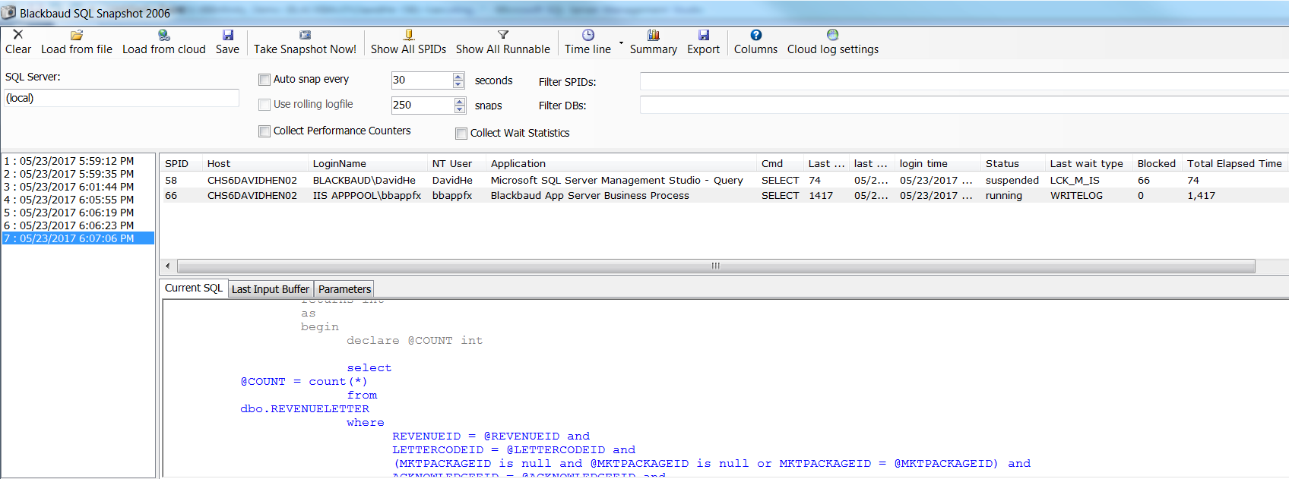
SQL Snap

Slide 13
Tracking Down Problematic Processes
Most processes in Blackbaud CRM follow a naming convention
Allows SQL to be linked to features in many cases
Catalog tables
Follow the format “[Feature Type]CATALOG”
Example: PAGEDEFINITIONCATALOG
Catalog items are linked by their ID
Except for data forms which are linked by their Data Form Instance ID
Instance tables store information on instances of features
BUSINESSPROCESSINSTANCE, ATTRIBUTECATEGORY, etc.
Parameter Set ID stores instance information for business processes
BUSINESSPROCESSSTATUS stores instances of individual business process executions
Status ID is appended to output table

Slide 14
Extended Events and Execution Plans
Extended Events
Low overhead system monitoring
Also useful for testing performance of changes
Measure reads, writes, CPU time, and execution time
See Introducing SQL Server Extended Events for more information
Query Execution Plans
Good for understanding the structure of query plan
Use in concert with Extended Events to understand and resolve problems

Slide 15
Questions?
david.hendershot@blackbaud.com

Slide 16


Thank you!

